Slide 1
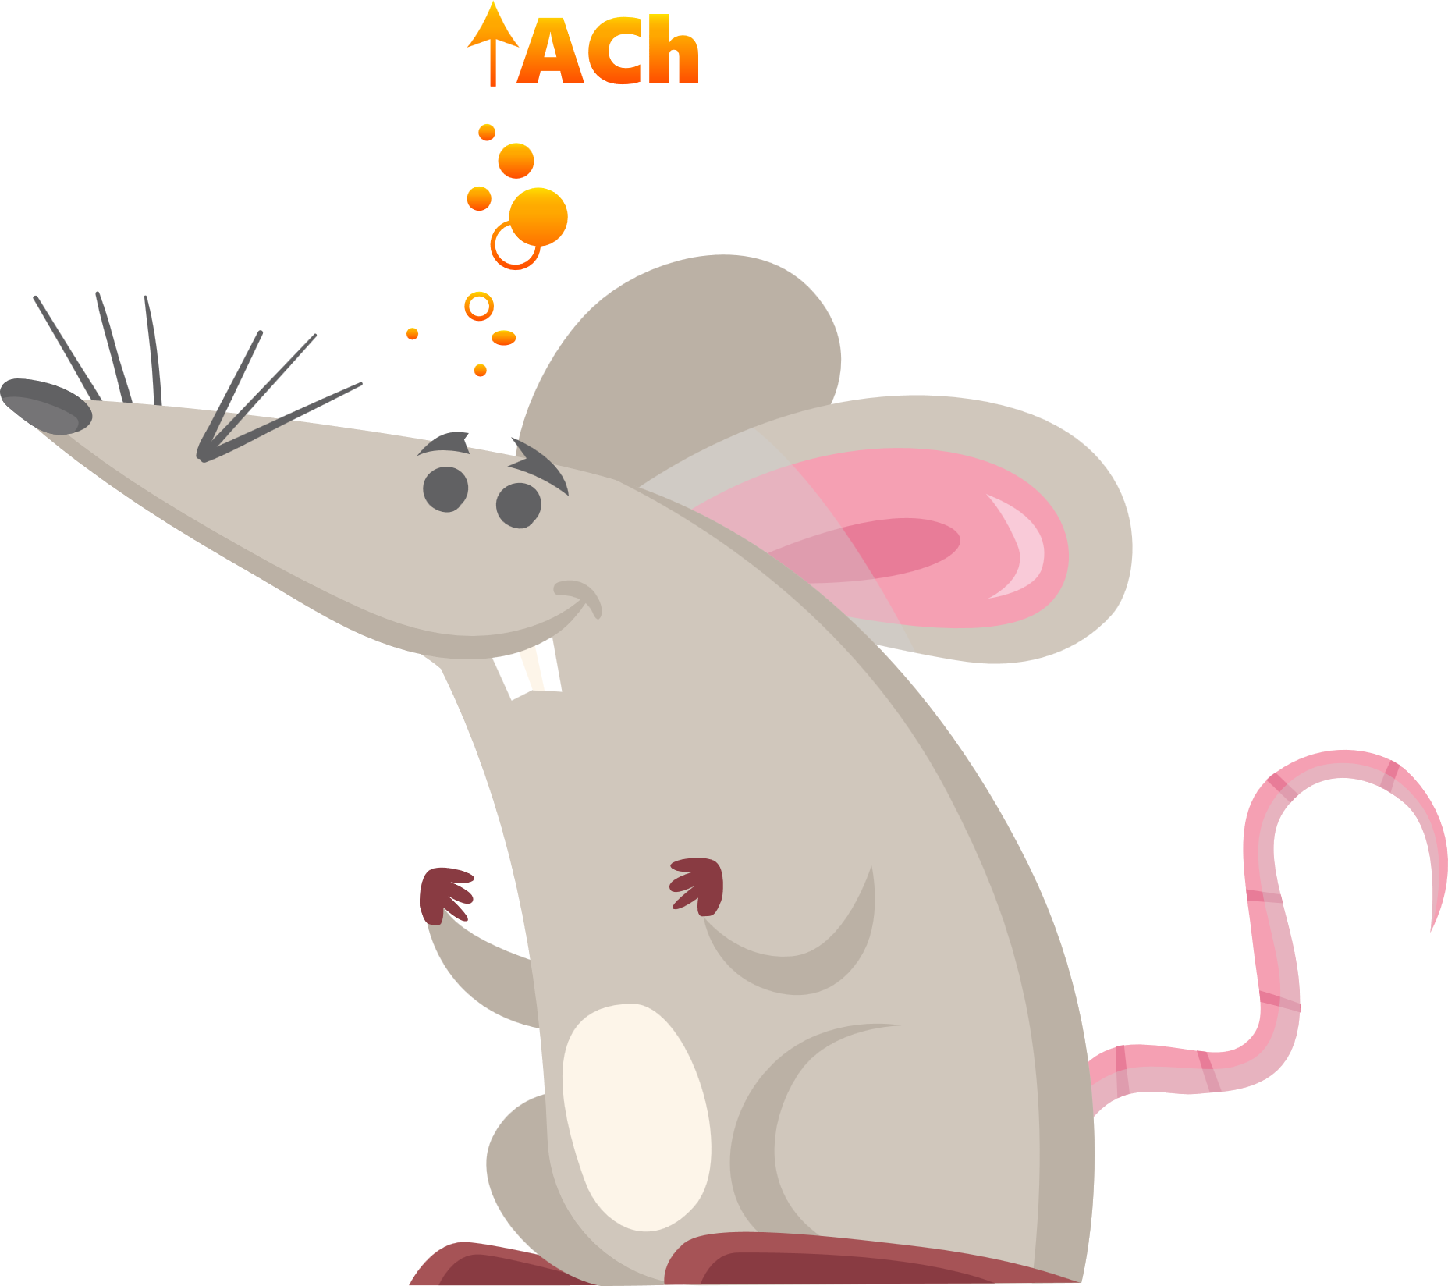



Acetylcholine (A.Ch) release in the basolateral amygdala (B.L.A) evolves as animals learn about actions and cues that lead to reward.

Slide 2




In novice animals, B.L.A. (A.Ch) increases when they earn the reward…
Novice
Reward
A.Ch

Slide 3
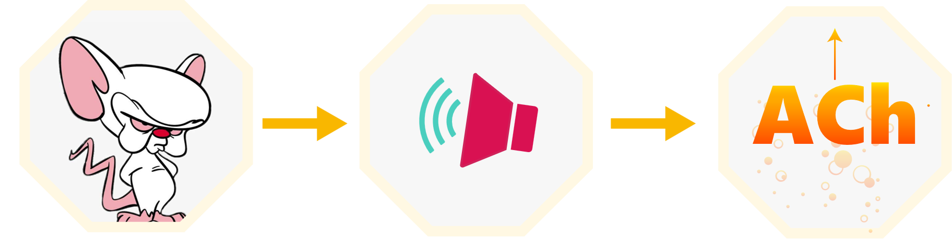
In trained, expert animals, A.Ch increases when they hear the cue before the reward…
Expert
Tone
A.Ch

Slide 4
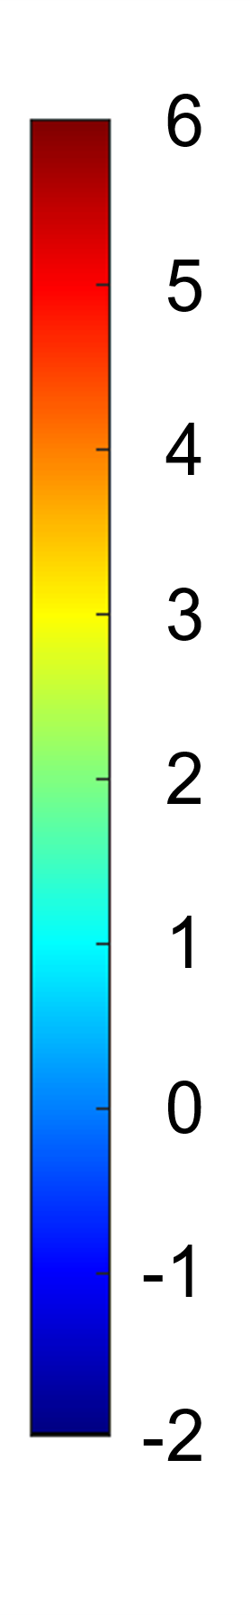

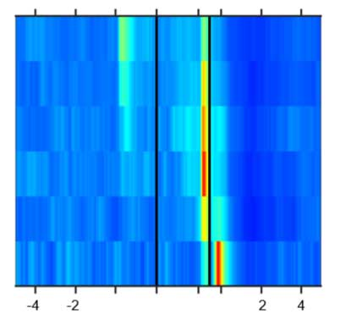


Notice that in untrained mice, A.Ch doesn’t really spike until the reward…
High [ACh]
Training
(No spike)
Novice
Low [ACh]
Tone
Nose
Poke
Reward

Slide 5
With more training, A.Ch release shifts earlier...
Nose
Poke
Tone
Reward
High [ACh]
Training
Novice
Low [ACh]

Slide 6
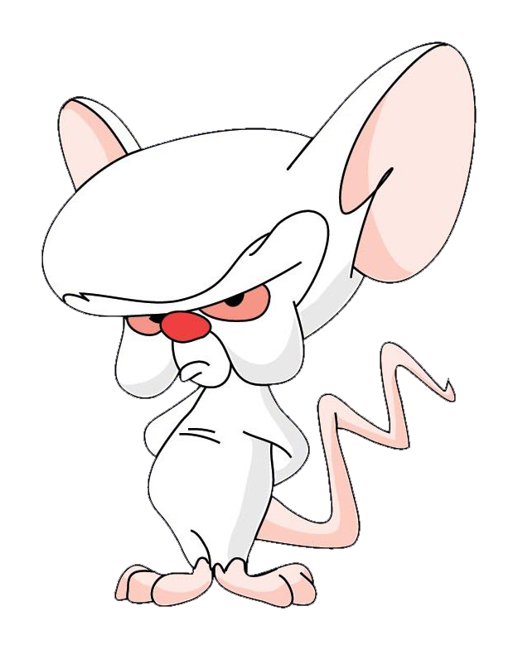
Here, in the expert mouse, you can see A.Ch spike earlier, on the tone...
Nose
Poke
Tone
Reward
Expert
High [ACh]
Training
Novice
Low [ACh]

Slide 7
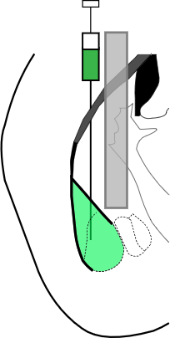
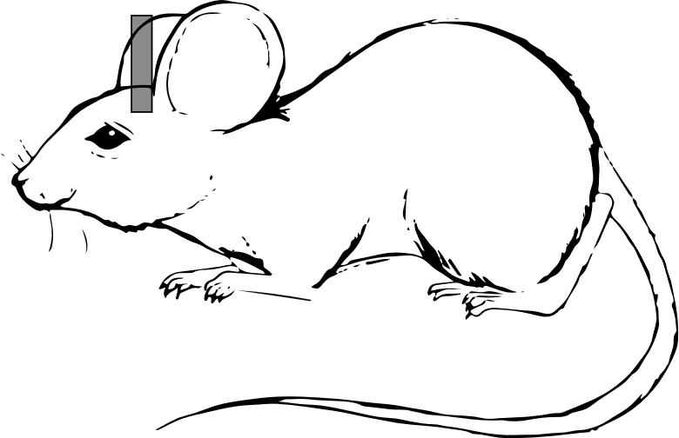
Methods
We recorded A.Ch in the B.L.A with Fluorescent A.Ch Sensor Fiber Photometry
Fluorescent A.Ch Sensor
Fiber Photometry
B.L.A
Injection and
Optical Fiber
GRAB_{ACh3.0}

Slide 8
The takeaway:
B.L.A A.Ch signaling carries important information about salient events in cue-reward learning

Slide 9
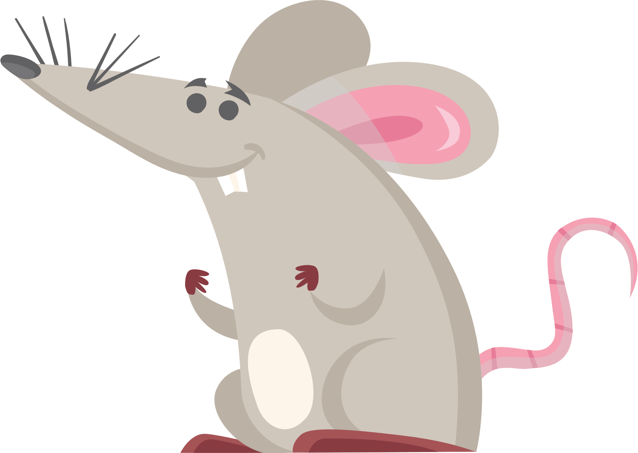

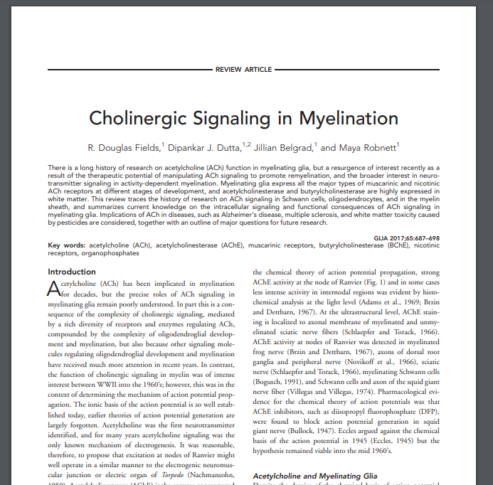
Thanks!
Watch the video version of this poster with extra detail, including where we increased A.Ch and improved learning.
Read the paper for details on our second study that manipulated A.Ch.
Contact Rick Crouse via email or Twitter

